Slide 1
Macau Cuisines
容逸朗
2020010869
School of Computer Science and Technology

Slide 2
Contents
PART 01
Macanese & Portuguese Dishes
PART 02
Local Food

Slide 3
1
Macanese & Portuguese Dishes
PART 01
The taste of the Mediterranean in Macao

Slide 4
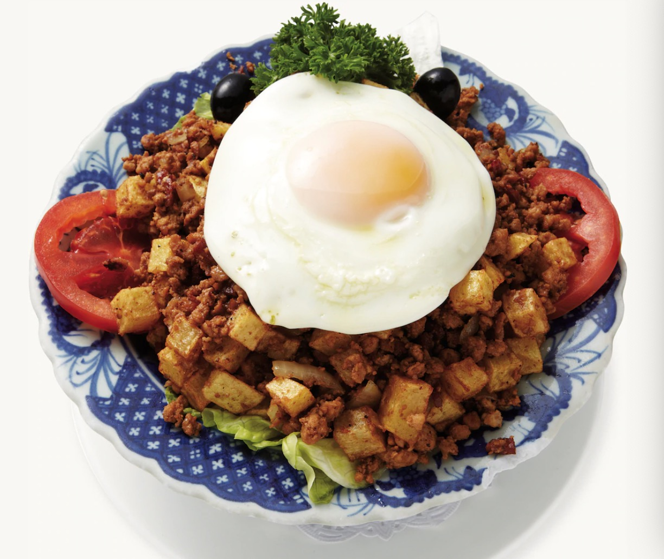
Minchi in Macao Style
It’s a dish of fried potatoes, onion, cheese and minced meat. This is eaten while mixing them with the egg yolk on top.
It is popular because you can find this dish from the menu of cha chaan teng. (茶餐厅, Hong Kong-style cafés)

Slide 5
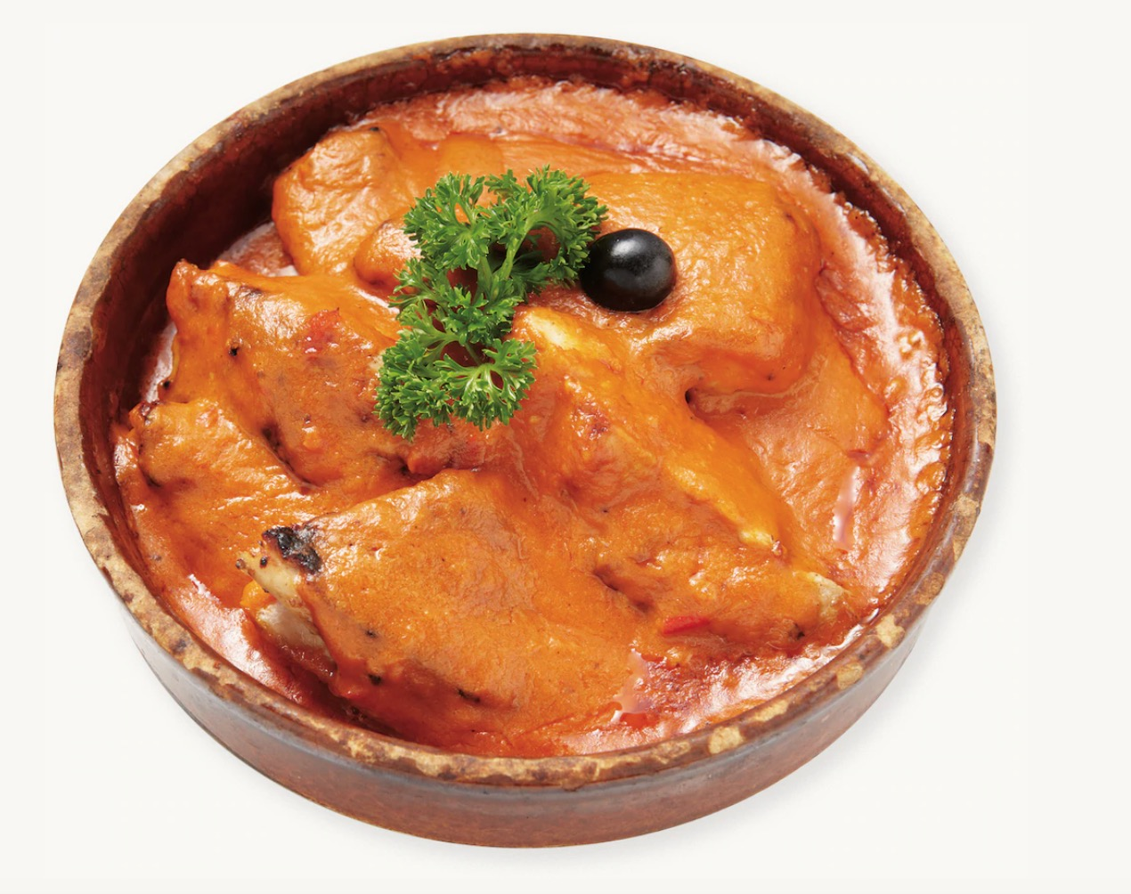
African Chicken
A traditional Portuguese dish of grilled chicken topped with piri piri sauce, which is a mix of pepper and herbs and has its own unique taste. The cooking style varies according to the restaurant, with some places having a slightly spicy curry sauce than the true piri piri, and some places pouring the sauce on top of the fried chicken.

Slide 6
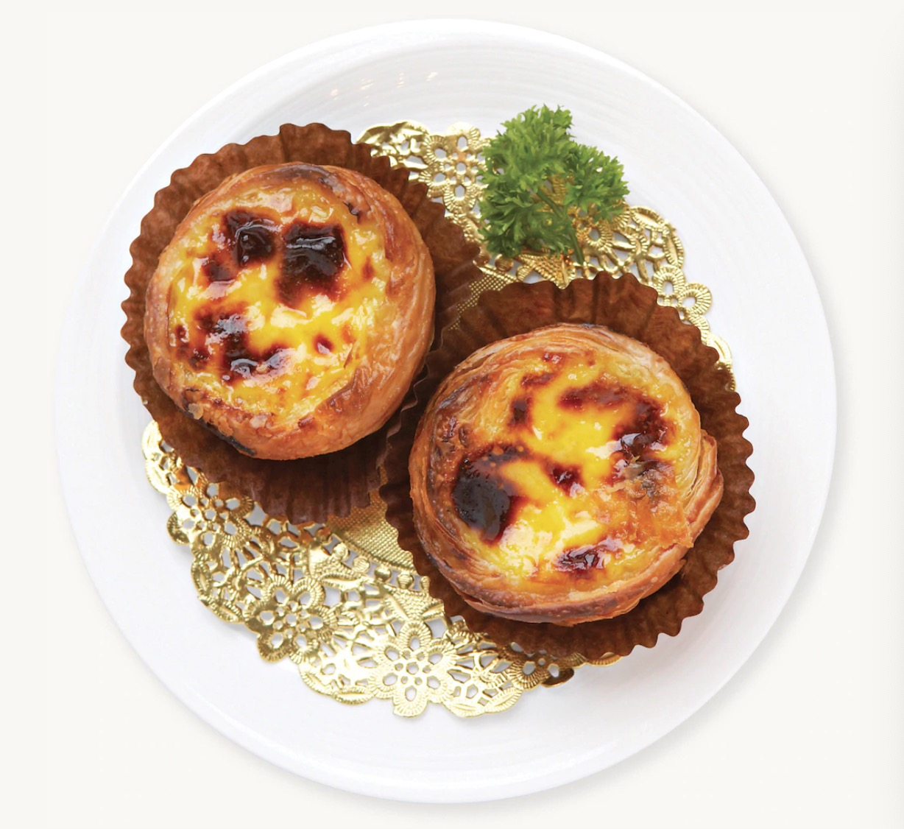
Portuguese Egg Tarts
Though this dessert originated in a monastery in Portugal 200 years ago, it became popular only after it arrived Macao.
The egg-custard stuffed pastry with a bitter caramel flavor really captivates everybody’s soul.

Slide 7
2
Local Food
PART 02
A taste of Macao's daily life

Slide 8
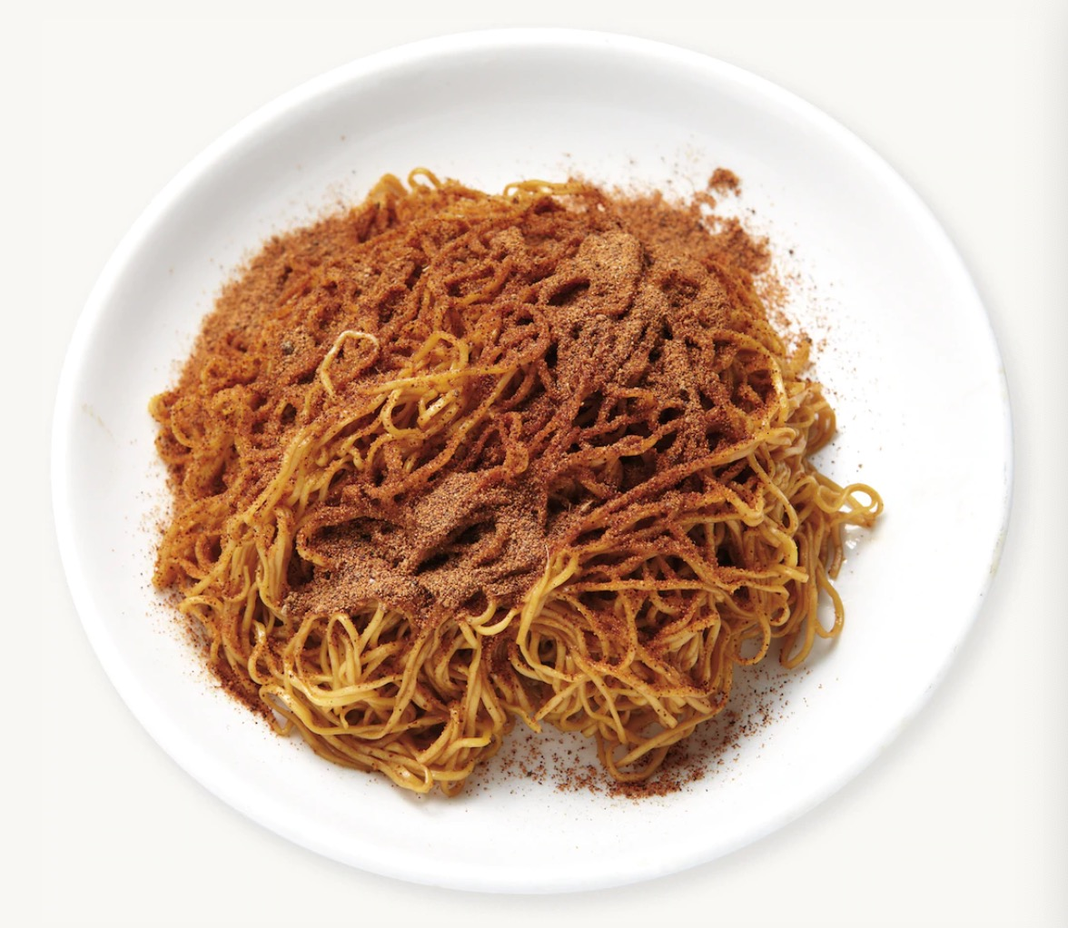
Dried Shrimp Roe Noodles
It’s dried noodles slightly fried with sea shrimp roe and mixed with egg noodles. The shrimp roe are too small to chew but as it breaks down between the teeth, the flavor is surprisingly strong, so that you can taste the salty sea in your mouth, even with a small amount. It is best with egg noodles that are as bouncy as string instruments.

Slide 9
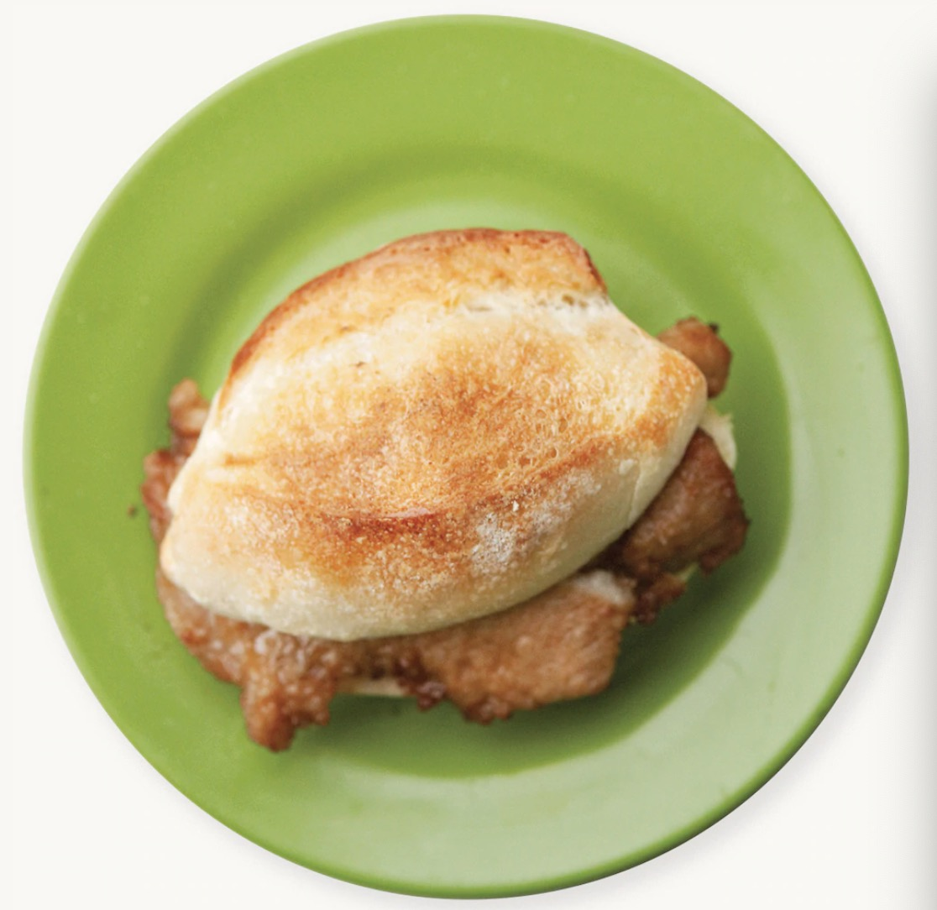
Pork Chop Bun
A Macao-style burger in a crispy baked baguette with thickly sliced grilled pork meat in between. It is different from a regular hamburger as it doesn’t have vegetables or sauce, but just meat to enjoy the taste, and the grilled charcoal flavor on the pork is a great combination.

Slide 10
Almond Cookies
These are some of Macao’s most popular traditional cookies. They have a lot of almonds, meaning every bite is crunchy, but it’s recommended that you eat it with a drink because it’s dry.

Slide 11
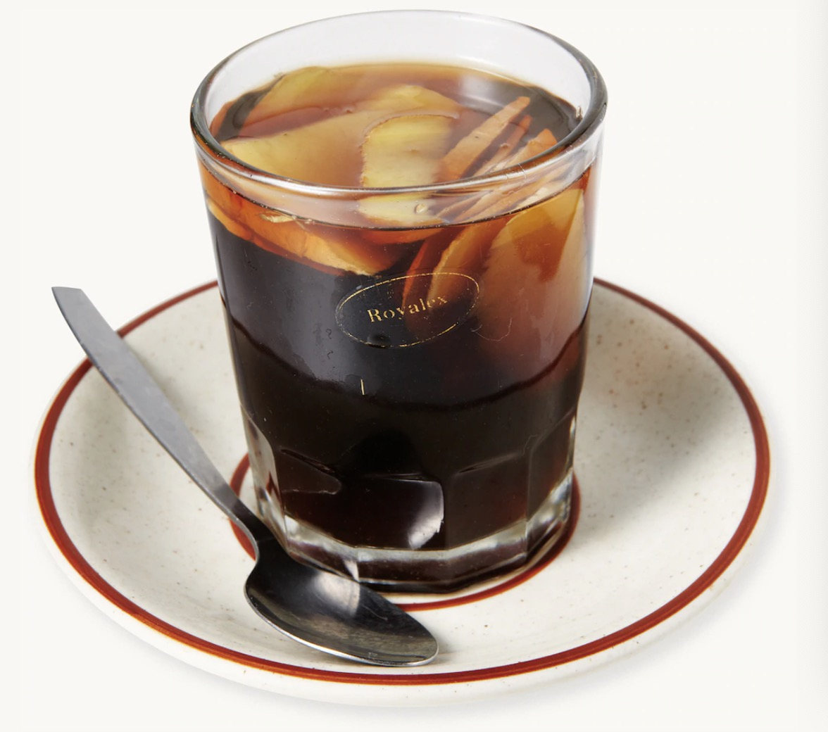
Coke Boiled with Ginger
Do not be surprised. This funny named drink is coke-boiled with ginger. It might sound weird to boil coke, but it’s good to drink it when you have a cold or are tired in order to gain energy. You might imagine a weird taste but it’s quite delicious. The combination of ginger and coke make an excellent flavor.

Slide 12
THE END
Thank You

